Slide 1
Quantum Computing Concepts: Entanglement and Interference
NPTEL Course on Quantum Computing: Week 2: Module 2
Lecturer: V. Ramakrishna
Senior Researcher and Quantum Ambassador
IBM Research—India

Slide 2
Outline
Qubit entanglement and Bell states
Bell measurement and quantum teleportation
Interference
Quantum algorithm construction

Slide 3
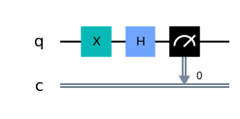
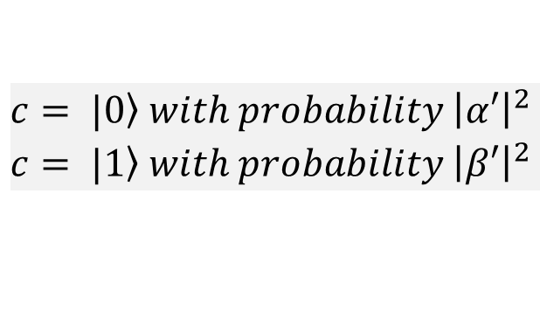

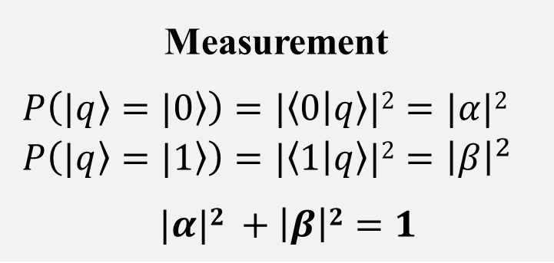

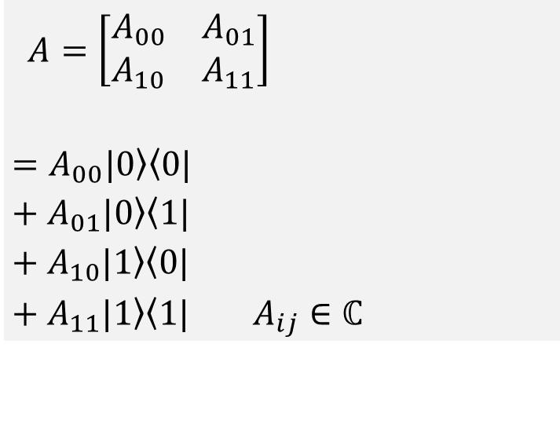
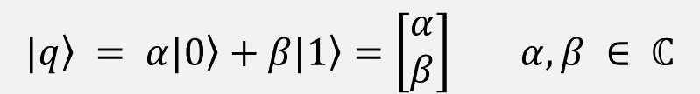

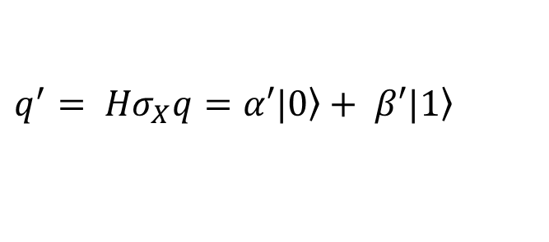
Recap: Single Qubits, Gates, and Circuits
Measurement
$$P\left(\left.|q\right\rangle =\left.|0\right\rangle \right)=|\left\langle 0 | q\right\rangle |2=|α|2$$
$$P\left(\left.|q\right\rangle =\left.|1\right\rangle \right)=|\left\langle 1 | q\right\rangle |2={\left|β\right|}^{2}$$
$|α|2$ $+ \left|β\right|2=1$
$\left.|q\right\rangle = α\left.|0\right\rangle +β\left.|1\right\rangle =\left[\begin{aligned}α \\ β\end{aligned}\right] α,β ∈ ℂ$
Single qubit
ket (vector)
bra-ket
(inner product: scalar)
Single qubit gate
A
$$\left.|q\right\rangle$$
$$\left.|q′\right\rangle$$
$$=A\left.|q\right\rangle$$
Single qubit circuit
Computation
$$q^{′}= {Hσ}_{X}q=α′\left.|0\right\rangle + β′\left.|1\right\rangle$$
$$A=\left[\begin{matrix}A_{00} & A_{01} \\ A_{10} & A_{11}\end{matrix}\right]$$
$=A_{00}\left.|0\right\rangle \left\langle 0|\right.$
$+ A_{01}\left.|0\right\rangle \left\langle 1|\right.$
$+ A_{10}\left.|1\right\rangle \left\langle 0|\right.$
$+ A_{11}\left.|1\right\rangle \left\langle 1|\right. A_{ij}∈ℂ$
ket-bra (outer product: matrix, or linear transformation)
Measurement (Output)
Input
$$c= \left.|0\right\rangle with probability {\left|α′\right|}^{2}$$
$$c= \left.|1\right\rangle with probability {\left|β′\right|}^{2}$$
Notes:
Speak about the multipartite state a bit more. Mention the size of the state (exponential). Connect to the multiple qubit gate at the bottom (individual qubits going into a gate and processed simultaneously). – DONE in next slide.
Move multiple qubit and multiple qubit gate to a separate slide. Talk about H*n gate (just circuit picture), with different representations (matrix, Dirac, tensor product). – DONE in next slide.

Slide 4
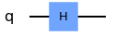



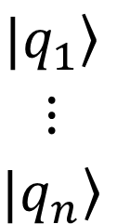
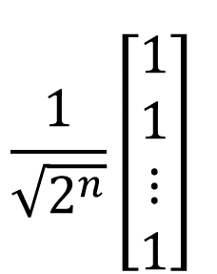






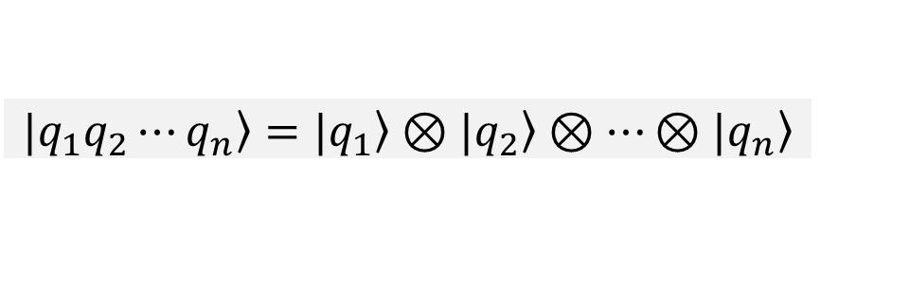


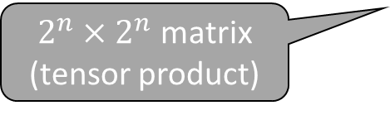
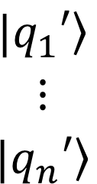


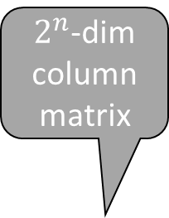
Recap: Multiple Qubits, Gates, and Circuits
Multiple qubit (multipartite) state
Producing a $2^{n}$state space from $n$ qubits
$$H^{⊗n}\left.|q_{1}q_{2}⋯q_{n}\right\rangle$$
$\left.|q_{1}q_{2}⋯q_{n}\right\rangle =\left.|q_{1}\right\rangle ⊗\left.|q_{2}\right\rangle$ $⊗⋯⊗\left.|q_{n}\right\rangle$
$$\left.|q_{1}\right\rangle$$
$$H\left.|q_{1}\right\rangle$$
Extra outputs for recovery of inputs: reversibility
Multiple qubit gate
$$\left.|q_{2}\right\rangle$$
$$H\left.|q_{2}\right\rangle$$
$2^{n}$-dim column matrix
A
$$\left.|q_{1}\right\rangle$$
$$⋮$$
$$\left.|q_{n}\right\rangle$$
$$\left.|q_{1}′\right\rangle$$
$$⋮$$
$$\left.|q_{n}′\right\rangle$$
$$⋮$$
$$⋮$$
$$⋮$$
$$\left.|q_{n}\right\rangle$$
$$H\left.|q_{n}\right\rangle$$
$$\frac{1}{\sqrt{2^{n}}}\left[\begin{aligned}1 \\ 1 \\ ⋮ \\ 1\end{aligned}\right]$$
$$H^{⊗n}$$
$2^{n}×2^{n}$ matrix (tensor product)
$${ H}^{⊗n}\left.|00⋯0\right\rangle =$$

Slide 5
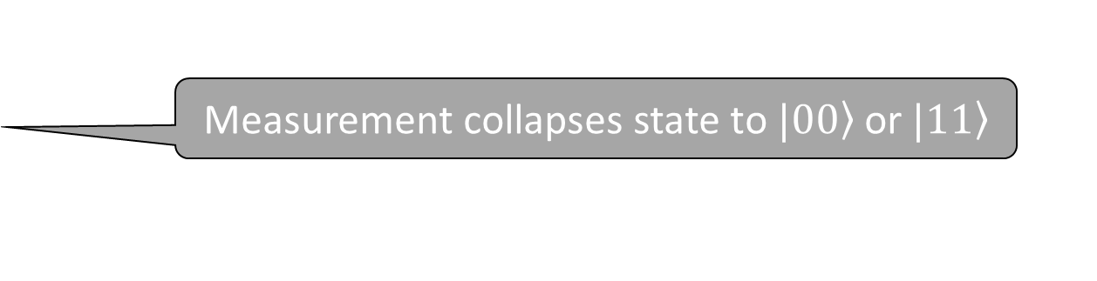
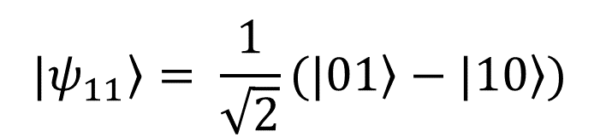
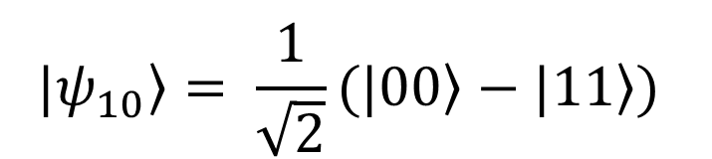
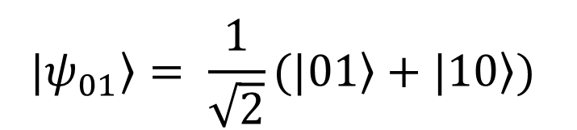
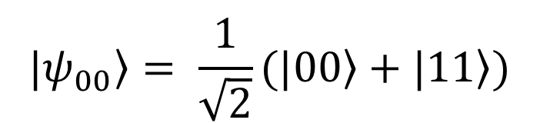
Entanglement: Bell States
Entangled state is a state $\left.|ψ\right\rangle$ that cannot be expressed as a tensor product $\left.|q_{1}\right\rangle ⊗\left.|q_{2}\right\rangle$
Bell States: four 2-qubit states that are maximally entangled
$$\left.|ψ_{00}\right\rangle = \frac{1}{\sqrt{2}}(\left.|00\right\rangle +\left.|11\right\rangle )$$
Measurement collapses state to $\left.|00\right\rangle$or $\left.|11\right\rangle$
$$\left.|ψ_{01}\right\rangle = \frac{1}{\sqrt{2}}(\left.|01\right\rangle +\left.|10\right\rangle )$$
If we measure the first qubit, we automatically know the state of the second
$$\left.|ψ_{10}\right\rangle = \frac{1}{\sqrt{2}}(\left.|00\right\rangle −\left.|11\right\rangle )$$
High amount of correlation, regardless of distance: useful in quantum computations
$$\left.|ψ_{11}\right\rangle = \frac{1}{\sqrt{2}}(\left.|01\right\rangle −\left.|10\right\rangle )$$
Notes:
Also Bell measurement

Slide 6
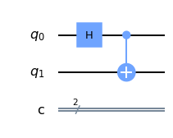


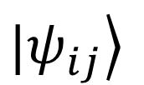
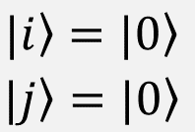
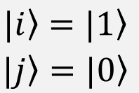






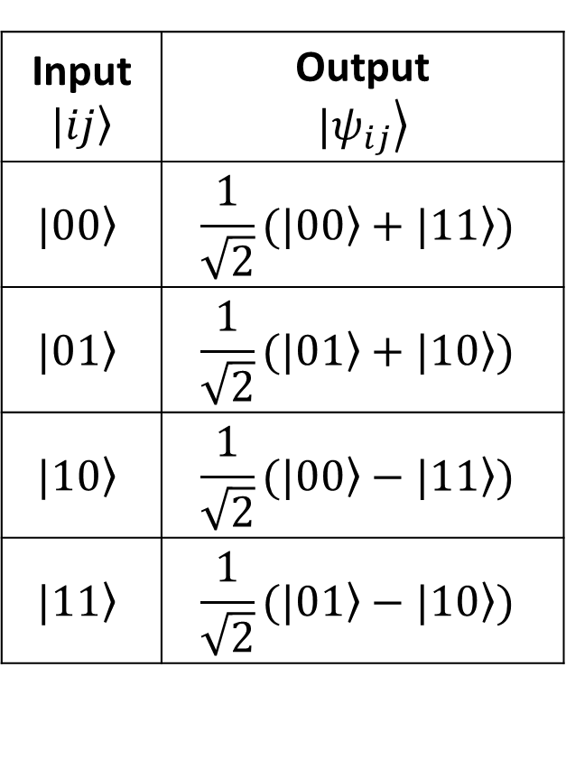


Entanglement: Circuit to Generate Bell States
Input $$\left.|ij\right\rangle$$ | Output $$\left.|ψ_{ij}\right\rangle$$
$$\left.|00\right\rangle$$ | $$\frac{1}{\sqrt{2}}(\left.|00\right\rangle +\left.|11\right\rangle )$$
$$\left.|01\right\rangle$$ | $$\frac{1}{\sqrt{2}}(\left.|01\right\rangle +\left.|10\right\rangle )$$
$$\left.|10\right\rangle$$ | $$\frac{1}{\sqrt{2}}(\left.|00\right\rangle −\left.|11\right\rangle )$$
$$\left.|11\right\rangle$$ | $$\frac{1}{\sqrt{2}}(\left.|01\right\rangle −\left.|10\right\rangle )$$
$$\left.|i\right\rangle$$
$$\left.|ψ_{ij}\right\rangle$$
$$\left.|j\right\rangle$$
$\frac{1}{\sqrt{2}}(\left.|0\right\rangle +\left.|1\right\rangle )\left.|0\right\rangle$
$$\left.|00\right\rangle$$
$=\frac{1}{\sqrt{2}}(\left.|00\right\rangle +\left.|11\right\rangle )$
$$\left.|i\right\rangle =\left.|0\right\rangle$$
$$\left.|j\right\rangle =\left.|0\right\rangle$$
$=\frac{1}{\sqrt{2}}(\left.|00\right\rangle +\left.|10\right\rangle )$
$\frac{1}{\sqrt{2}}(\left.|0\right\rangle −\left.|1\right\rangle )\left.|0\right\rangle$
$$\left.|10\right\rangle$$
$=\frac{1}{\sqrt{2}}(\left.|00\right\rangle −\left.|11\right\rangle )$
$$\left.|i\right\rangle =\left.|1\right\rangle$$
$$\left.|j\right\rangle =\left.|0\right\rangle$$
$=\frac{1}{\sqrt{2}}(\left.|00\right\rangle −\left.|10\right\rangle )$
Try deriving the other two Bell states as exercises!
Notes:
Mention that the other two are exercises. - DONE

Slide 7
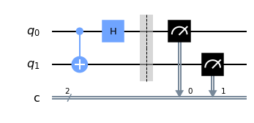
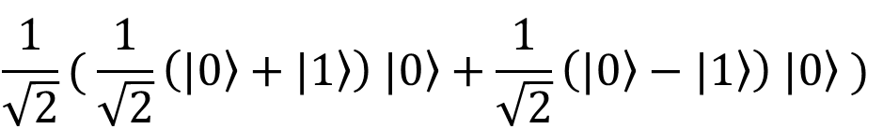

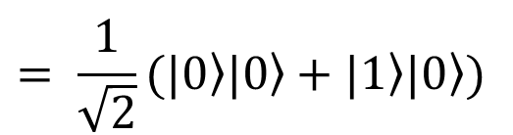




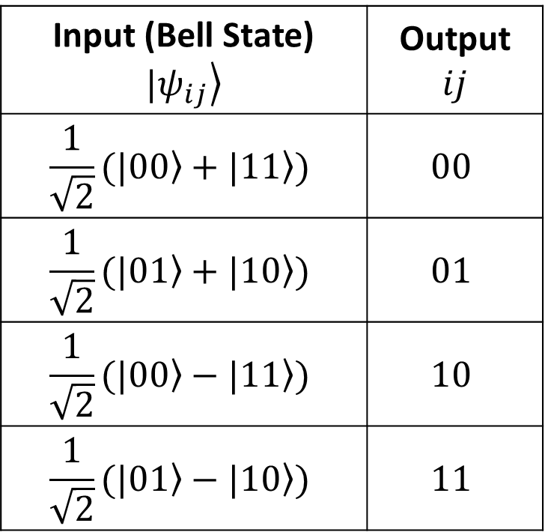
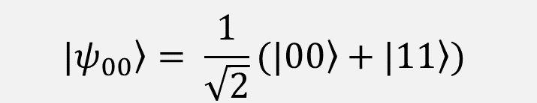


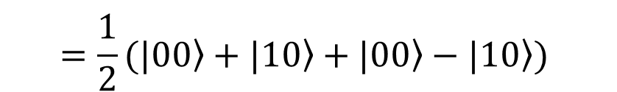

Entanglement: Bell Measurement
The reverse problem: given $\left.|ψ_{ij}\right\rangle$ find $i$ and $j$
Solution: reverse the circuit
$$\left.|ψ_{00}\right\rangle = \frac{1}{\sqrt{2}}(\left.|00\right\rangle +\left.|11\right\rangle )$$
Maximally entangled Bell state
Input (Bell State) $$\left.|ψ_{ij}\right\rangle$$ | Output $$ij$$
$$\frac{1}{\sqrt{2}}(\left.|00\right\rangle +\left.|11\right\rangle )$$ | $$00$$
$$\frac{1}{\sqrt{2}}(\left.|01\right\rangle +\left.|10\right\rangle )$$ | $$01$$
$$\frac{1}{\sqrt{2}}(\left.|00\right\rangle −\left.|11\right\rangle )$$ | $$10$$
$$\frac{1}{\sqrt{2}}(\left.|01\right\rangle −\left.|10\right\rangle )$$ | $$11$$
$$\frac{1}{\sqrt{2}}(\left.|00\right\rangle +\left.|10\right\rangle )$$
$$= \frac{1}{\sqrt{2}}(\left.|0\right\rangle \left.|0\right\rangle +\left.|1\right\rangle \left.|0\right\rangle )$$
$$\left.|ψ_{ij}\right\rangle$$
$$\left.|ψ_{00}\right\rangle$$
$$\frac{1}{\sqrt{2}}( \frac{1}{\sqrt{2}}\left(\left.|0\right\rangle +\left.|1\right\rangle \right) \left.|0\right\rangle +\frac{1}{\sqrt{2}}\left(\left.|0\right\rangle −\left.|1\right\rangle \right) \left.|0\right\rangle )$$
$$=\frac{1}{2}(\left.|00\right\rangle +\left.|10\right\rangle +\left.|00\right\rangle −\left.|10\right\rangle )$$
$$i$$
$$=0$$
$$j$$
$$=0$$
$$=\left.|00\right\rangle$$
Notes:
Circuit image; calculations at stages; measurement result
Remaining states as exercises. - MENTION

Slide 8






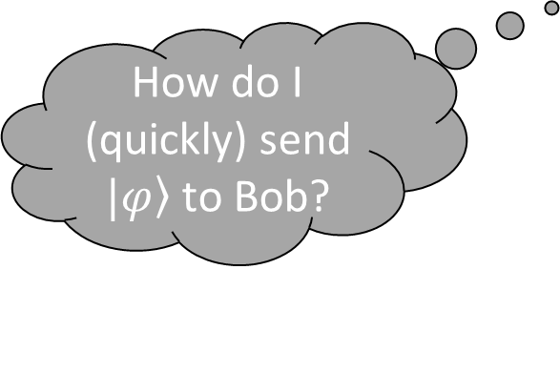
Quantum Teleportation
No, this is not Sci-Fi!
It’s about communicating information over arbitrarily long distances using the power of quantum entanglement
Consider the following scenario
Moves to a galaxy far, far away…….
$$\left.|φ\right\rangle =\text{α}\text{|0⟩ + }\text{β}\text{|1⟩}$$
$$\left.|i\right\rangle$$
How do I (quickly) send $\left.|φ\right\rangle$ to Bob?
$$\left.|ψ_{ij}\right\rangle AB$$
Alice
$$\left.|j\right\rangle$$
Bob
Bell state
Notes:
Alice and Bob keep one of two maximally entangled qubits (e.g., a Bell state) and then Bob moves to a galaxy far far away…
Add subscript ‘AB’ against the psi-ij state. (Mention that this belongs to Alice and Bob, and that we will drop this convention in the subsequent slides as it is implied.) - DONE
Remove single subscripts terms (inaccurate). Add arrow with psi-ij connecting Alice and Bob at a long distance. - DONE
Alice’s state needs to be transported to Bob without using an explicit “copy”. (use Prabha’s slide as the next slide, before the protocol.)
The strange phenomenon in which two photons or other quantum bodies behave as one unit, even if spatially separate.

Slide 9
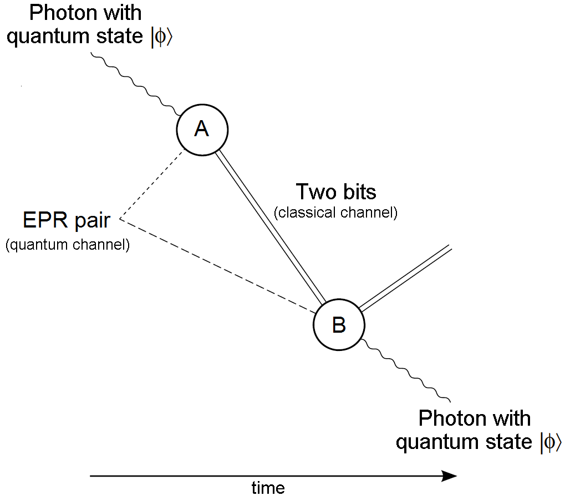
Quantum Teleportation: Protocol Overview
Einstein-Podolsky-Rosen
Bell state

Slide 10


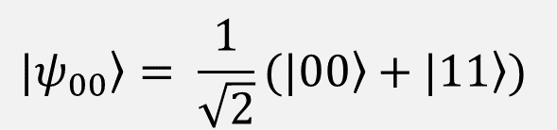



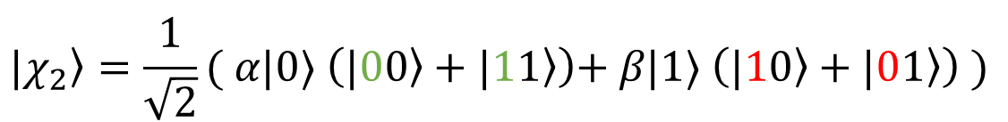





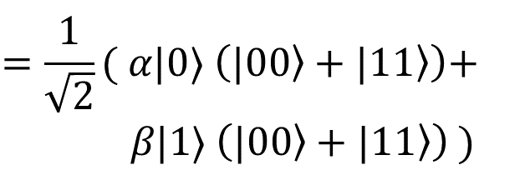




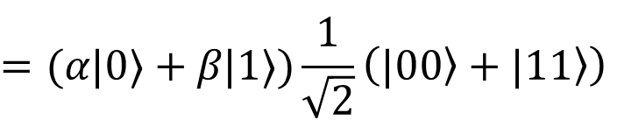
Teleportation Protocol
Solution: use Bell Measurement
$$\left.|φ\right\rangle$$
$$\left.|ψ_{00}\right\rangle = \frac{1}{\sqrt{2}}(\left.|00\right\rangle +\left.|11\right\rangle )$$
$$M$$
Alice
$$N$$
Start state
$$\left.|χ_{1}\right\rangle =\left.|φ\right\rangle ⊗\left.|ψ_{00}\right\rangle$$
$\left.|ψ_{ij}\right\rangle$
$$\left.|ψ_{00}\right\rangle$$
$$=(\text{α}\text{|0⟩ + }\text{β}\text{|1⟩})\left. |ψ_{00}\right\rangle$$
$$M$$
$$N$$
$$\left.|φ\right\rangle$$
Bob
$$\left.|χ_{1}\right\rangle$$
$$\left.|χ_{2}\right\rangle$$
$$=(\text{α}\text{|0⟩ + }\text{β}\text{|1⟩})\frac{1}{\sqrt{2}}\left(\left.|00\right\rangle +\left.|11\right\rangle \right)$$
$$\left.|χ_{2}\right\rangle =\frac{1}{\sqrt{2}}( \text{α}\text{|0⟩ }\left(\left.|00\right\rangle +\left.|11\right\rangle \right)\text{+ }\text{β}\text{|1⟩ }\left(\left.|10\right\rangle +\left.|01\right\rangle \right) )$$
3-qubit state
$$=\frac{1}{\sqrt{2}}( \text{α}\text{|0⟩ }\left(\left.|00\right\rangle +\left.|11\right\rangle \right)\text{+ } \text{β}\text{|1⟩ }\left(\left.|00\right\rangle +\left.|11\right\rangle \right) )$$
CNOT
Notes:
Start by talking about 3 qubits. Add the AB subscripts in the circuit and against “Start state”. Later add the Z and X gates and make the claim that it can recover phi. - DONE
Start state: add tensor operator and subscript AB after psi. - DONE
Use chi instead of theta. - DONE
Exercise: try with Bell states other than psi-00.

Slide 11

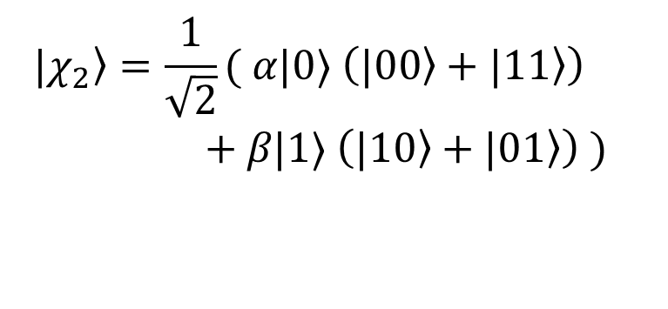

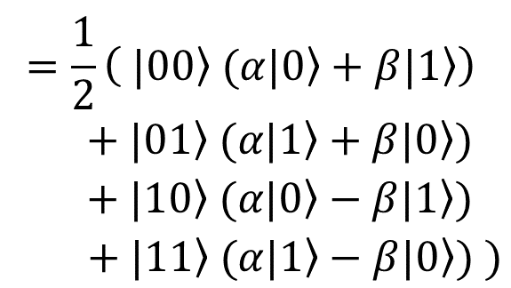


Teleportation Protocol
Solution: use Bell Measurement
$$\left.|χ_{2}\right\rangle =\frac{1}{\sqrt{2}}( \text{α}\text{|0⟩ }\left(\left.|00\right\rangle +\left.|11\right\rangle \right)$$
$\text{+ }\text{β}\text{|1⟩ }\left(\left.|10\right\rangle +\left.|01\right\rangle \right) )$
$$\left.|φ\right\rangle$$
$$M$$
Alice
$$N$$
$$\left.|ψ_{00}\right\rangle$$
Hadamard
$$M$$
$$N$$
$$\left.|φ\right\rangle$$
Bob
$$\left.|χ_{1}\right\rangle$$
$$\left.|χ_{2}\right\rangle$$
$$\left.|χ_{3}\right\rangle$$
$$=\frac{1}{2}\left( \left.|00\right\rangle \text{ (}\text{α}\left.|0\right\rangle +\text{β}\left.|1\right\rangle \right)$$
$$+ \left.|01\right\rangle \text{(}\text{α}\left.|1\right\rangle +\text{β}\left.|0\right\rangle )$$
$$+ \left.|10\right\rangle \text{(}\text{α}\left.|0\right\rangle −\text{β}\left.|1\right\rangle )$$
$$+\left. |11\right\rangle \text{(}\text{α}\left.|1\right\rangle −\text{β}\left.|0\right\rangle ) )$$
$$\left.|χ_{3}\right\rangle =\frac{1}{\sqrt{2}}( \text{α}\frac{1}{\sqrt{2}}(\left.|0\right\rangle +\left.|1\right\rangle )\left(\left.|00\right\rangle +\left.|11\right\rangle \right) \text{+ }\text{β}\frac{1}{\sqrt{2}}(\left.|0\right\rangle −\left.|1\right\rangle )\left(\left.|10\right\rangle +\left.|01\right\rangle \right) )$$
$$=\frac{1}{2}( \text{α}(\left.|000\right\rangle +\left.|011\right\rangle +\left.|100\right\rangle +\left.|111\right\rangle ) \text{+ }\text{β}(\left.|010\right\rangle +\left.|001\right\rangle −\left.|110\right\rangle −\left.|101\right\rangle ) )$$
$$=\frac{1}{2}( \text{α}(\left.|000\right\rangle +\left.|011\right\rangle +\left.|100\right\rangle +\left.|111\right\rangle ) \text{+ }\text{β}(\left.|010\right\rangle +\left.|001\right\rangle −\left.|110\right\rangle −\left.|101\right\rangle ) )$$
Notes:
Use chi instead of theta. - DONE
Exercise: try with Bell states other than psi-00.

Slide 12





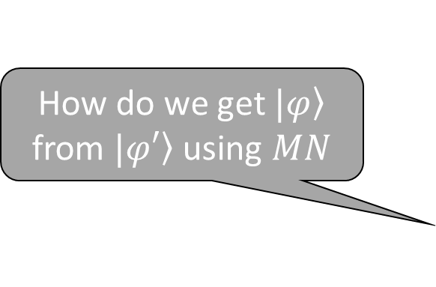



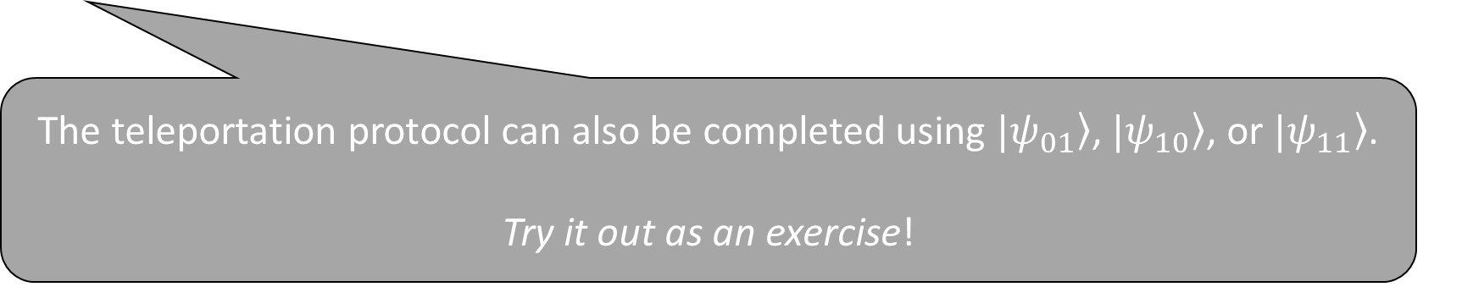

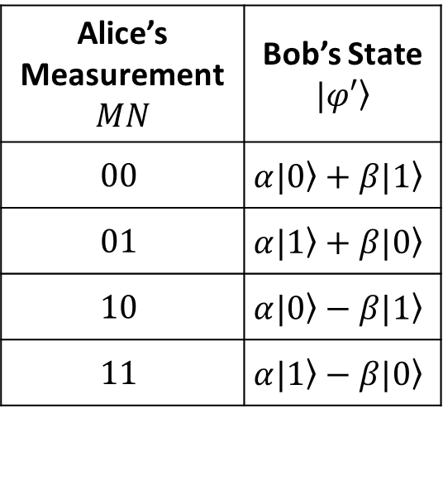




Teleportation Protocol
Solution: use Bell Measurement
$$\left.|φ\right\rangle$$
Alice’s Measurement $$MN$$ | Bob’s State $$\left.|φ′\right\rangle$$
$$00$$ | $$\text{α}\left.|0\right\rangle +\text{β}\left.|1\right\rangle$$
$$01$$ | $$\text{α}\left.|1\right\rangle +\text{β}\left.|0\right\rangle$$
$$10$$ | $$\text{α}\left.|0\right\rangle −\text{β}\left.|1\right\rangle$$
$$11$$ | $$\text{α}\left.|1\right\rangle −\text{β}\left.|0\right\rangle$$
$$M$$
How do we get $\left.|φ\right\rangle$ from $\left.|φ′\right\rangle$using $MN$
Alice
$$N$$
$$\left.|ψ_{00}\right\rangle$$
$$M$$
$$N$$
$$\left.|φ\right\rangle$$
Bob
The teleportation protocol can also be completed using $\left.|ψ_{01}\right\rangle$, $\left.|ψ_{10}\right\rangle$, or $\left.|ψ_{11}\right\rangle$.
Try it out as an exercise!
$$\left.|χ_{1}\right\rangle$$
$$\left.|χ_{2}\right\rangle$$
$$\left.|χ_{3}\right\rangle$$
$$\left.|φ′\right\rangle$$
$\left.|χ_{3}\right\rangle =\frac{1}{2}\left( \left.|00\right\rangle \text{ (}\text{α}\left.|0\right\rangle +\text{β}\left.|1\right\rangle \right)+ \left.|01\right\rangle \text{(}\text{α}\left.|1\right\rangle +\text{β}\left.|0\right\rangle )$ $+ \left.|10\right\rangle \text{(}\text{α}\left.|0\right\rangle −\text{β}\left.|1\right\rangle )$ $+\left. |11\right\rangle \text{(}\text{α}\left.|1\right\rangle −\text{β}\left.|0\right\rangle ) )$
$$MN=00$$
Do nothing
$$0$$
$$0$$
$$MN=10$$
Phase flip (Z gate)
$$1$$
$$0$$
$$MN=01$$
Bit flip (X gate)
$$0$$
$$1$$
$$MN=11$$
Bit and phase flip (X and Z gates)
$$1$$
$$1$$
Notes:
Exercise: try with Bell states other than psi-00. – EXAM QUESTION

Slide 13



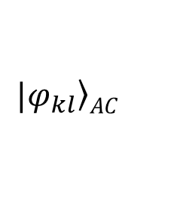
More About Teleportation
This it not just theory. It has been experimentally verified.
Teleportation protocol demonstrated in China between ground and satellite (~1400 km)
Entanglement swapping demonstrated between two of the Canary Islands (~143 km)
$$\left.|ψ_{ij}\right\rangle AB$$
$$\left.|φ_{kl}\right\rangle AC$$
Bob
Alice
Carol
Teleportation
Measurements
$$\left.|ψ_{ij}\right\rangle AC$$
So does this mean we can communicate information infinitely fast over long distances?
No, because the Bell measurement results can only be communicated over classical communication channels, which cannot exceed the speed of light.
Notes:
Mention that we need classical communication of measurement results, which can’t be faster than the speed of light.
Experimentally verified in China and Canary Islands.
Show the entanglement swapping in a picture rather than in the callout boxes.
Exercise: try with Bell states other than psi-00.

Slide 14
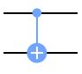



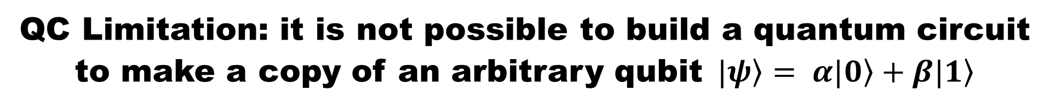








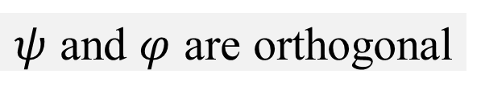




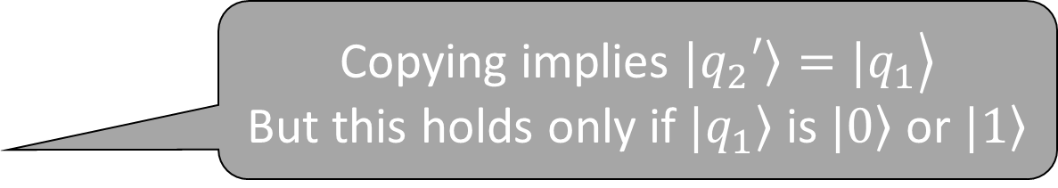




No-Cloning Theorem
QC Limitation: it is not possible to build a quantum circuit to make a copy of an arbitrary qubit$\left. |ψ\right\rangle = α\left.|0\right\rangle +β\left.|1\right\rangle$
Meaning? There is no unitary transformation that can produce two copies of an arbitrary$\left. |ψ\right\rangle$
$$\underset{→}{U}$$
Another big difference from classical computing, where copying an arbitrary bit is a basic operation
$$\left.|ψ\right\rangle ⊗\left.|s\right\rangle$$
$$U(\left.|ψ\right\rangle ⊗\left.|s\right\rangle )$$
$$= \left.|ψ\right\rangle ⊗\left.|ψ\right\rangle$$
But wait...
Didn’t Alice teleport a qubit to Bob?
Yes, but as a result, Alice lost the qubit after measurement
Copying implies $\left.\left.|q_{2}′\right\rangle =|q_{1}\right\rangle$
But this holds only if $\left.|q_{1}\right\rangle$ is $\left.|0\right\rangle$ or $\left.|1\right\rangle$
Compute inner products of LHS and RHS
$$U(\left.|ψ\right\rangle ⊗\left.|s\right\rangle )$$
$$= \left.|ψ\right\rangle ⊗\left.|ψ\right\rangle$$
What about the CNOT gate?
$$\left.|q_{1}\right\rangle$$
$$U(\left.|φ\right\rangle ⊗\left.|s\right\rangle )$$
$$= \left.|φ\right\rangle ⊗\left.|φ\right\rangle$$
$$\left.|q_{1}\right\rangle$$
$$(U^{\text{†}}\left\langle ψ|\right.⊗\left\langle s|\right.)(U\left(\left.|φ\right\rangle ⊗\left.|s\right\rangle \right))$$
$$=(\left\langle ψ|\right.⊗\left\langle ψ|)(\right.\left.|φ\right\rangle ⊗\left.|φ\right\rangle )$$
$$\left.|q_{2}\right\rangle$$
$$\left.\left.|q_{2}′\right\rangle =|q_{1}⊕q_{2}\right\rangle$$
$$\left\langle ψ | φ\right\rangle ={(\left\langle ψ | φ\right\rangle )}^{2}$$
$$ψ=φ$$
OR
$ψ$ and $φ$ are orthogonal
Notes:
There’s another interesting way in which QC is fundamentally different from CC - MENTION
But wait…….didn’t we just see Alice teleport an arbitrary qubit to Bob?
CNOT gate: can only copy classical bit (0 or 1).
Draw a box (from Nielsen) showing that copying can’t be done unless the state inputs are orthogonal. - DONE
No-cloning means that there is no unitary transformation that can produce two copies of an arbitrary qubit supplied as input. This is mathematically provable; there’s a short and elegant proof that I encourage you to look up; it’s based on concepts and terminology we have already discussed, like Dirac representation of states, linear transformations, and tensor products.

Slide 15
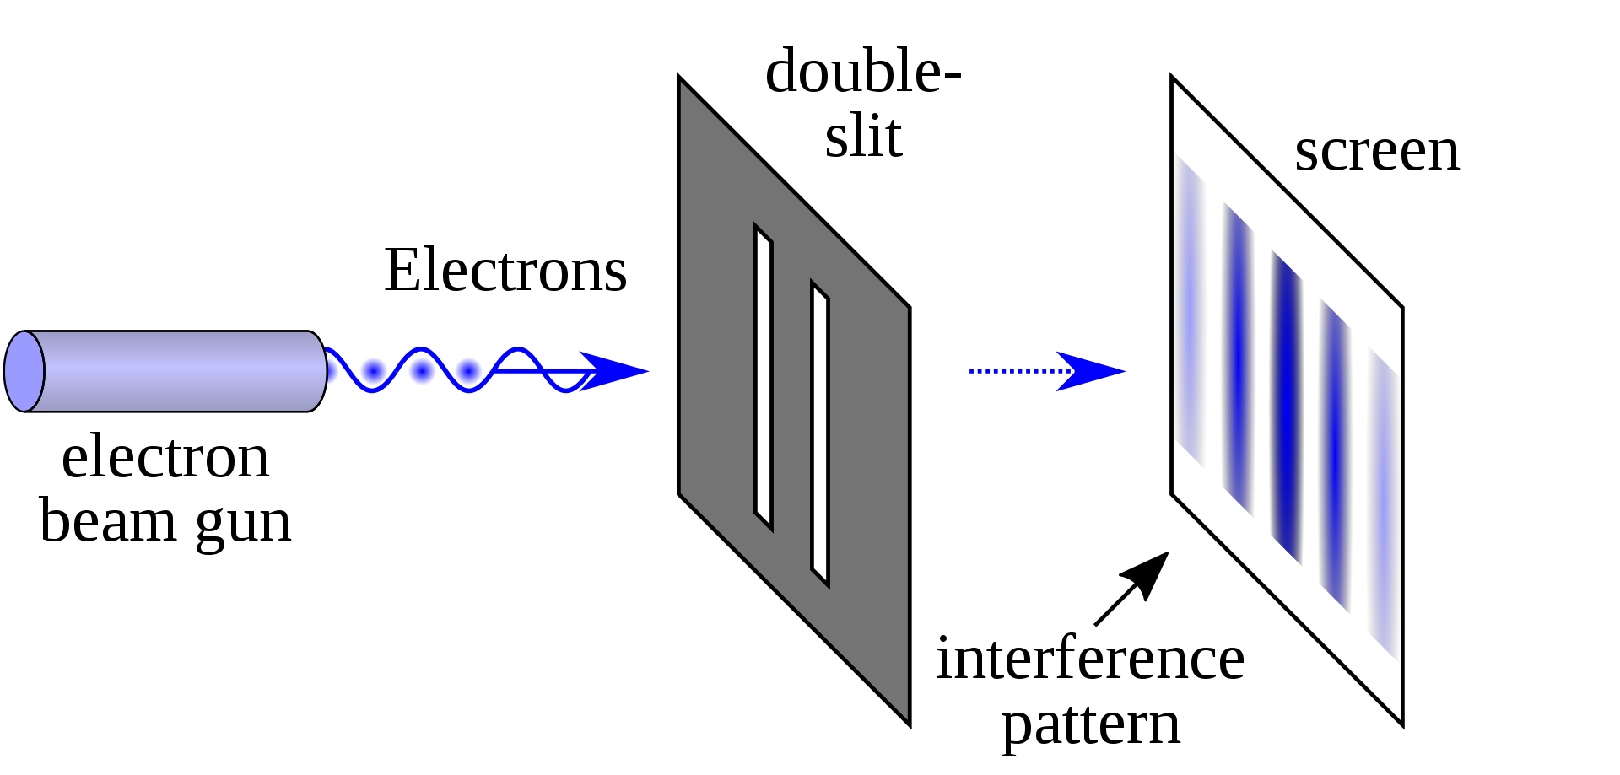
Interference
Unique properties of quantum mechanics applied in quantum computing: superposition, entanglement, interference
Quantum mechanical units exhibit wave-particle duality
Wave behavior produces interference effects
Constructive interference: phases are aligned and amplitudes add up
Destructive interference: out of phase and cancel each other out
In quantum circuits, we can apply suitable phase changes (through gates) to superposition states to amplify desired states (for our computation) and diminish other states
Source: Wikipedia
By !Original: NekoJaNekoJaVector: Johannes Kalliauer - File:Double-slit.PNG, CC BY-SA 4.0, https://commons.wikimedia.org/w/index.php?curid=61496401
Notes:
Add picture with double slit experiment, light/dark fringes. - DONE

Slide 16
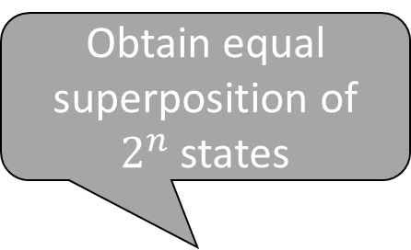

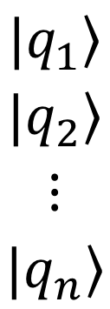
The Intuition Behind Quantum Algorithm Construction
Perform transformations of superposition states, and use entanglement and interference effects to bias correct answers (states) and diminish incorrect ones
Determine state space and inputs
Obtain equal superposition of $2^{n}$ states
$$\left.|q_{1}\right\rangle$$
$$\left.|q_{2}\right\rangle$$
$$⋮$$
$$\left.|q_{n}\right\rangle$$
H
Combination of Gates
H
H
$$c$$
Measure outputs using a number of shots for high accuracy
Notes:
Talk about applying H to all n input qubits, thereby producing exponential size superposition state with equal probability of each combination. Then perform computations to bias each qubit to produce the desired output by applying a suitable sequence of gates. Finally measure to get the desired answer with high probability (though use a large number of shots to get higher accuracy). This sequence of operations has biased an exponential-size state space to determine the right answer (state) without running into exponential complexity.

Slide 17
Summary and Preview of Next Lesson
Thus far, you have learned
Qubits, quantum gates, and circuits
How the quantum mechanical properties of superposition, entanglement, and interference, can be harnessed to build quantum computing algorithms
Next, we will move from theory to practice
You will see how to create quantum circuits on IBM Quantum Computers and write programs using Qiskit
Notes:
Replace with “Next, we’ll demonstrate all the qubit gates and circuits in practice, using IBM-Q and Qiskit.”

